Slide 1
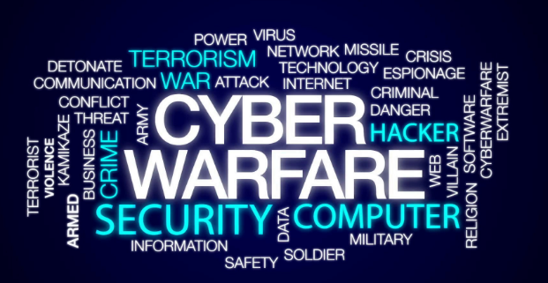
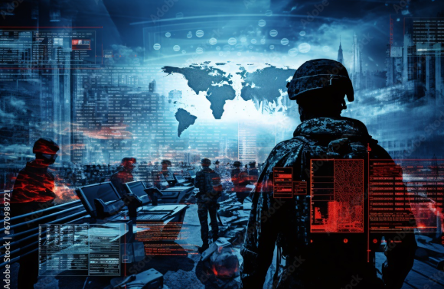
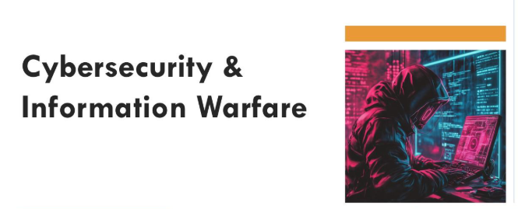
Cyber Terrorism and Information Warfare

Slide 2
Cyber terrorism
Terrorism is the act of creating fear through violence to achieve specific goals.
Cyber terrorism is the use of the internet, computers, or digital networks to carry out attacks that create fear, panic, or harm people, governments, or organizations for political, ideological, or religious purposes.
Examples:
Hacking government or bank systems
Spreading extremist propaganda online
Launching cyber attacks (like shutting down websites)
Threats or coordination of attacks through social media

Slide 3
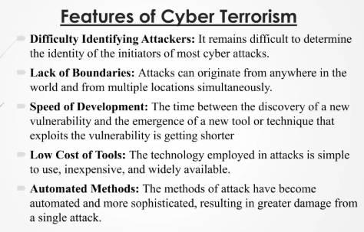

Slide 4
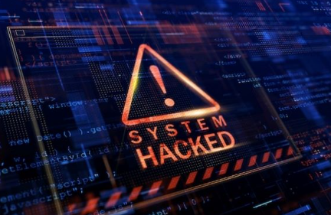
Real Life Example
Ukraine Power Grid Attack
Hackers successfully shut down electricity in parts of Ukraine. This attack directly impacted civilians, proving that cyber attacks can damage critical infrastructure and create fear similar to physical terrorism.
ISIS Online Propaganda
The group used the internet for recruitment, spreading fear, and propaganda. This shows that cyber terrorism is not only about hacking but also about influencing minds and spreading terror digitally.

Slide 5
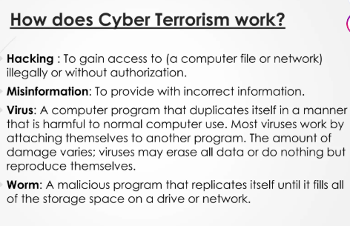

Slide 6
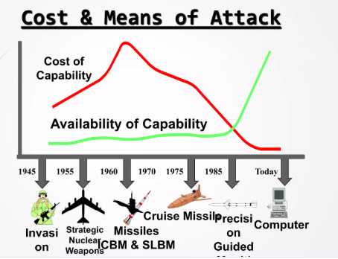
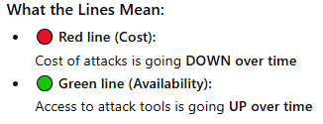
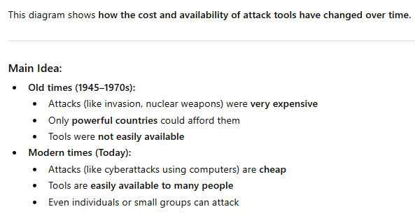
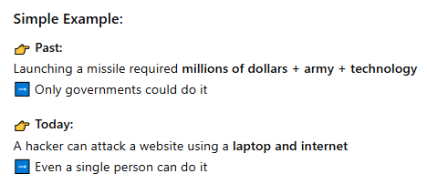

Slide 7
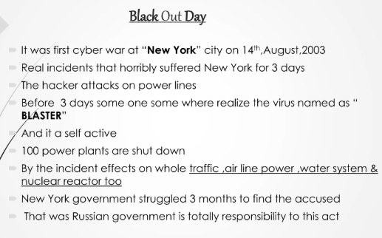

Slide 8
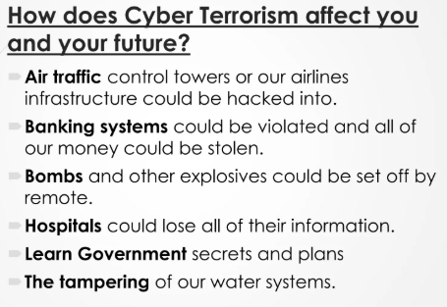
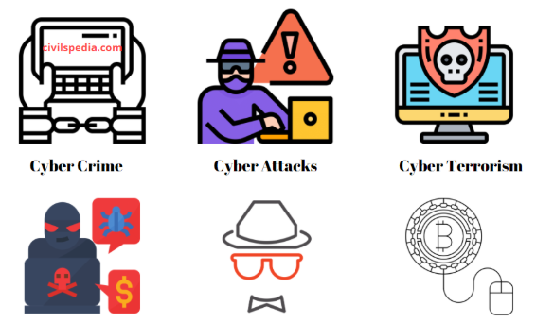

Slide 9
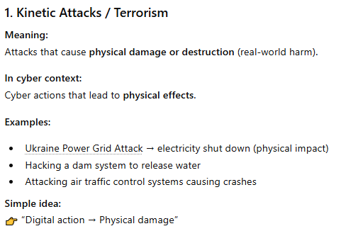
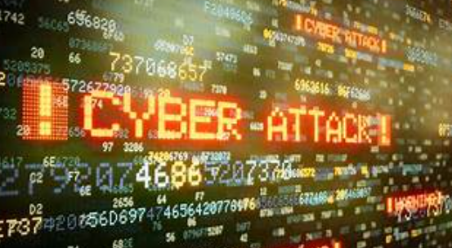

Slide 10
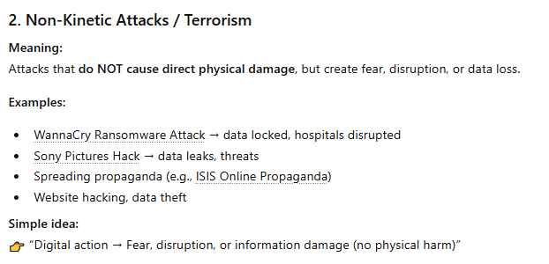

Slide 11
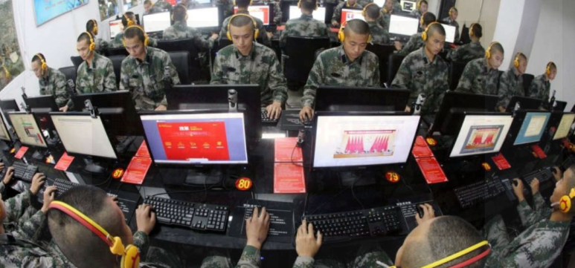

China Eagle Union
China Eagle Union is believed to be a Chinese hacker group associated with cyber activities, especially in the early days of cyber warfare.
What they are known for:
Conducting hacking operations against foreign websites
Involved in cyber conflicts with other countries (especially the U.S.)
Promoting nationalistic hacking (hacktivism)
Example:
If political tension increases between two countries, groups like China Eagle Union may:
Deface websites
Launch cyber attacks
Spread digital propaganda

Slide 12
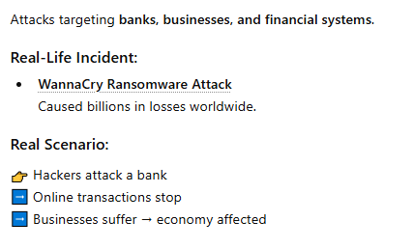

Economic attacks

Slide 13
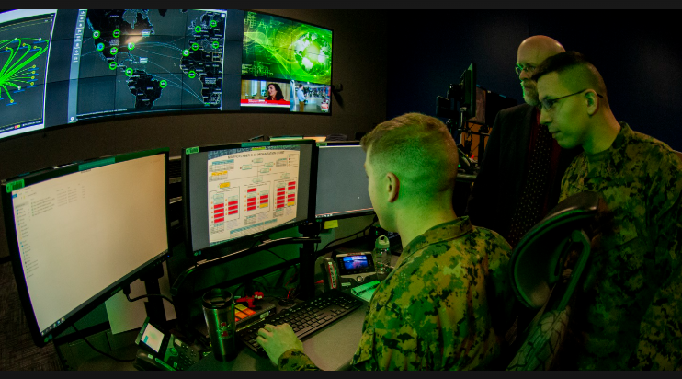
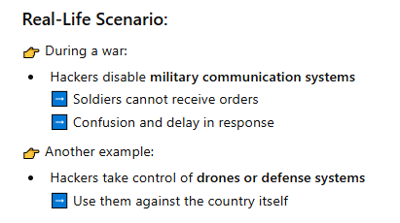
Military operations attacks
Military cyber attacks are actions where computer systems are used to target a country’s defense and military infrastructure to weaken its power or readiness.
What do they target?
Army communication systems
Radar and surveillance systems
Missile control systems
Defense databases
Military satellites

Slide 14
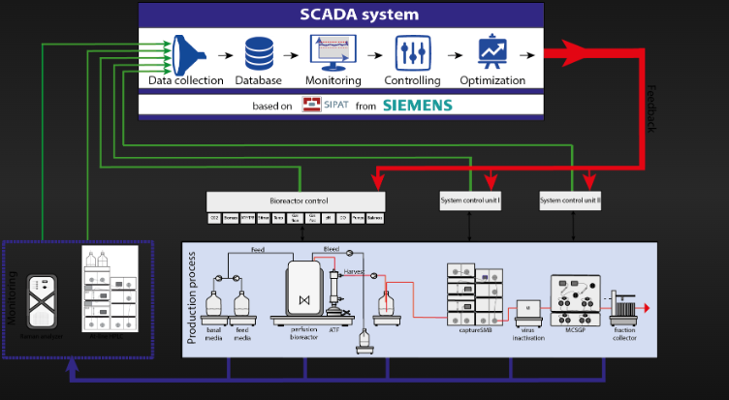
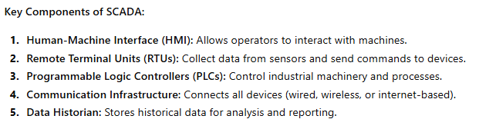
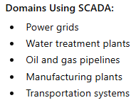
Supervisory control and data acquisitions
SCADA stands for Supervisory Control and Data Acquisition. It is a system used to monitor and control industrial processes, infrastructure, and facility-based operations remotely. SCADA systems are critical for national infrastructure, which makes them a major target for cyber terrorism

Slide 15
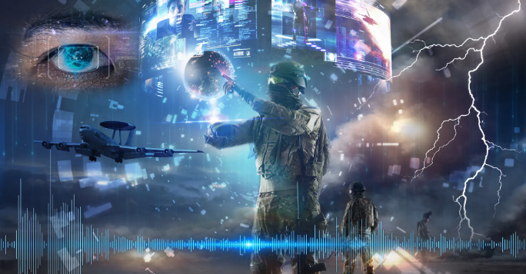
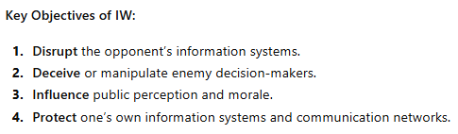
Information warfare
Information Warfare (IW) refers to the use and management of information to gain a strategic advantage over an opponent. In modern contexts, it often involves cyber operations, psychological operations, and disruption of communication systems.
It’s not just hacking; it’s a strategic battle over information, affecting decision-making, public perception, and critical infrastructure.

Slide 16
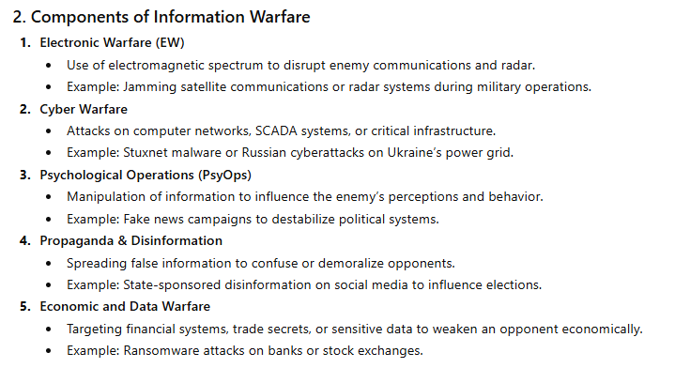

Slide 17
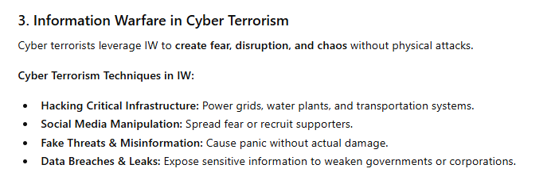


Slide 18
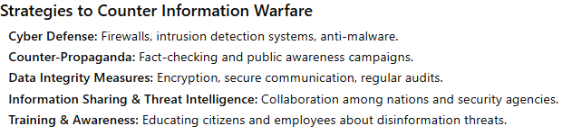

Slide 19
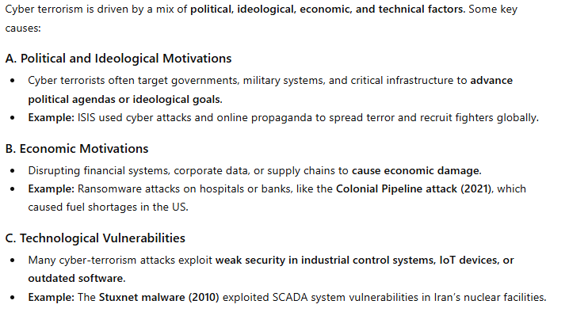
Actual cases Future trends

Slide 20
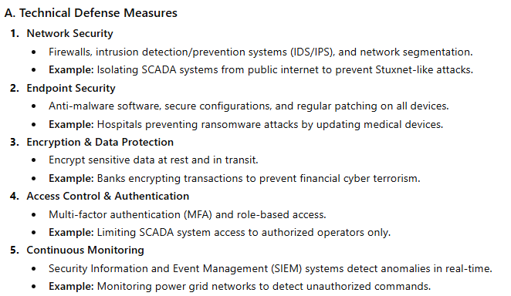
Defense against cyber terrorism
Defense against cyber terrorism involves protecting critical infrastructure, data, and information systems from malicious attacks carried out by terrorists to cause disruption, fear, or economic loss. It’s a multi-layered approach combining technology, policies, and human awareness.

Slide 21
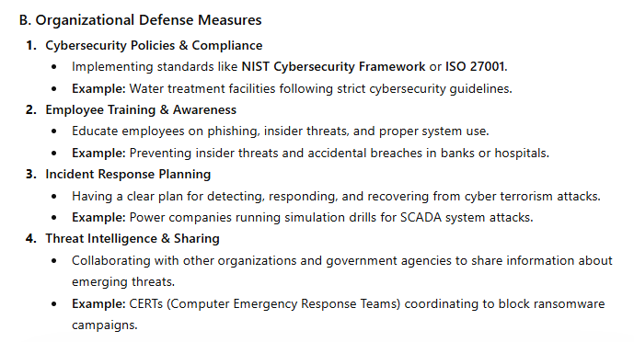

Slide 22
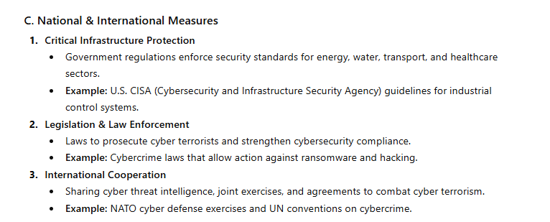

Slide 23
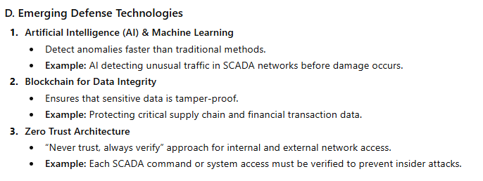

Slide 24
